Slide 1
Chapter 3 Objectives
The CCNA Topics Covered in this chapter include:
  Frame Relay
  PPP

Slide 2
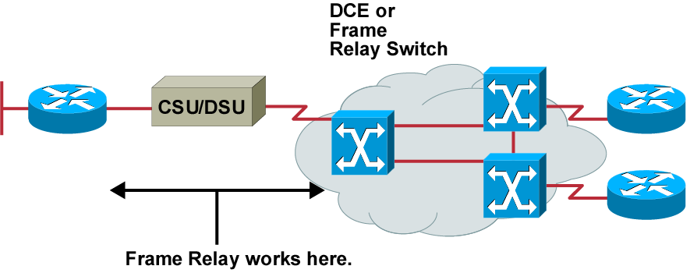
Frame Relay Overview
  Connections made by virtual circuits
  Connection-oriented service

Slide 3
Frame Relay
Purpose
  Provide a communications interface between DTE & DCE equipment
  Connection-oriented Data Link layer communication
    Via virtual circuits
    Provides a complete path from the source to destination before sending the first frame

Slide 4
Frame Relay Stack
OSI Reference Model
Frame Relay
Application
Presentation
Session
Transport
Network
IP/IPX/AppleTalk, etc.
Data-Link
Frame Relay
EIA/TIA-232, EIA/TIA-449, V.35, X.21, EIA/TIA-530
Physical

Slide 5
Frame Relay
Background
  High-performance WAN encapsulation method
  OSI Physical & data Link layer
  Originally designed for use across ISDN
Supported Protocols
  IP, DECnet, AppleTalk, Xerox Network Service (XNS), Novell IPX, Banyan Vines, Transparent Bridging, & ISO

Slide 6
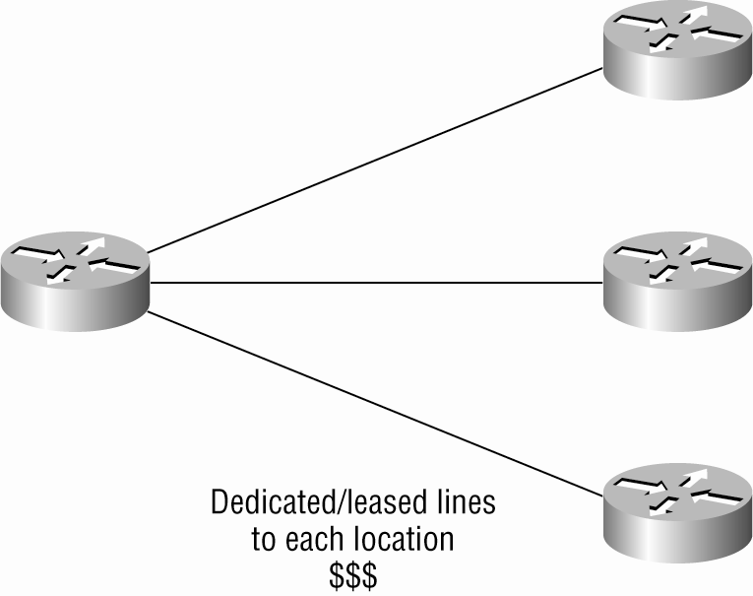
Before Frame Relay

Slide 7
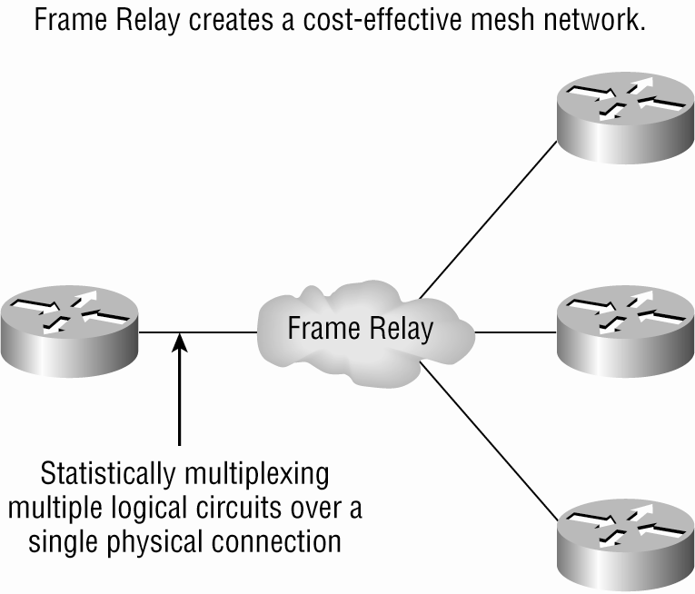
After Frame Relay

Slide 8
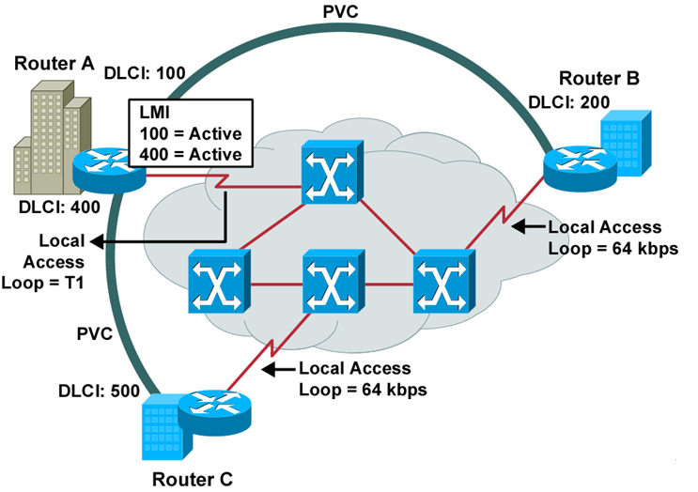
Frame Relay Terminology

Slide 9
Committed Information Rate (CIR)
Definition: Provision allowing customers to purchase amounts of bandwidth lower than what they might need
  Cost savings
  Good for bursty traffic
  Not good for constant amounts of data transmission

Slide 10
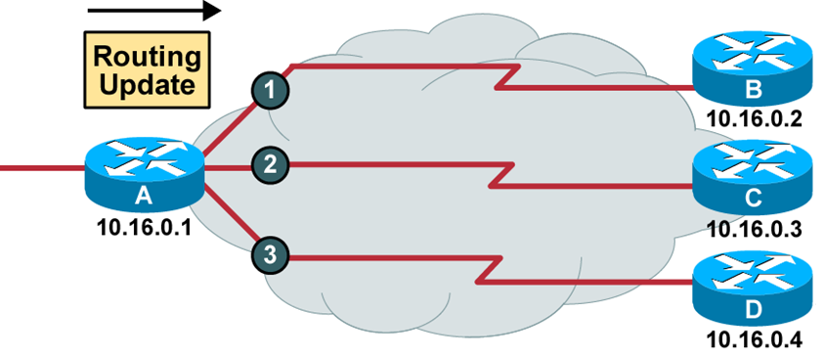
Reachability Issues with Routing Updates
Problem:
  Broadcast traffic must be replicated for each active connection.
  Split-horizon rule prevents routing updates received on
  one interface from being forwarded out the same interface.

Slide 11
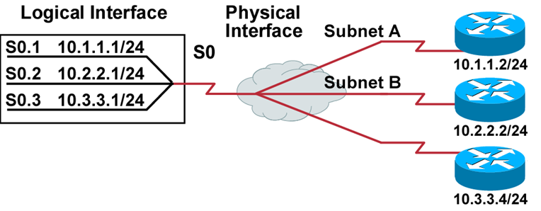
Resolving Reachability Issues
Split horizon can cause problems in NBMA environments.
Subinterfaces can resolve split horizon issues.
Solution: A single physical interface simulates multiple logical interfaces.

Slide 12
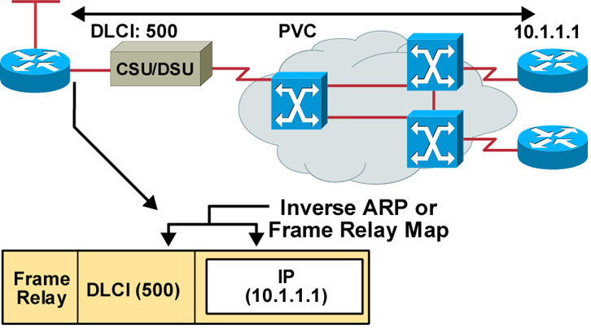
Frame Relay Address Mapping
  Use LMI to get locally significant DLCI from the Frame Relay switch.
  Use Inverse ARP to map the local DLCI to the remote router’s network layer address.

Slide 13
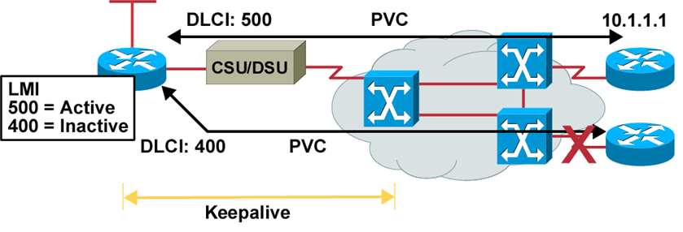
Frame Relay Signaling
  Cisco supports three LMI standards:
    Cisco
    ANSI T1.617 Annex D
    ITU-T Q.933 Annex A

Slide 14
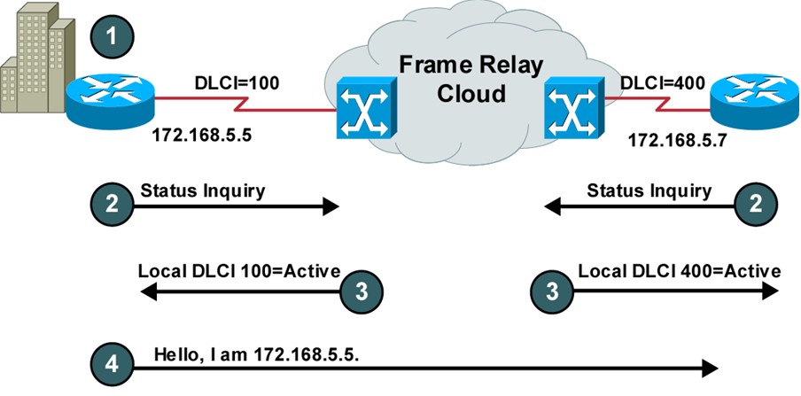
Frame Relay Inverse ARP and LMI Signaling

Slide 15
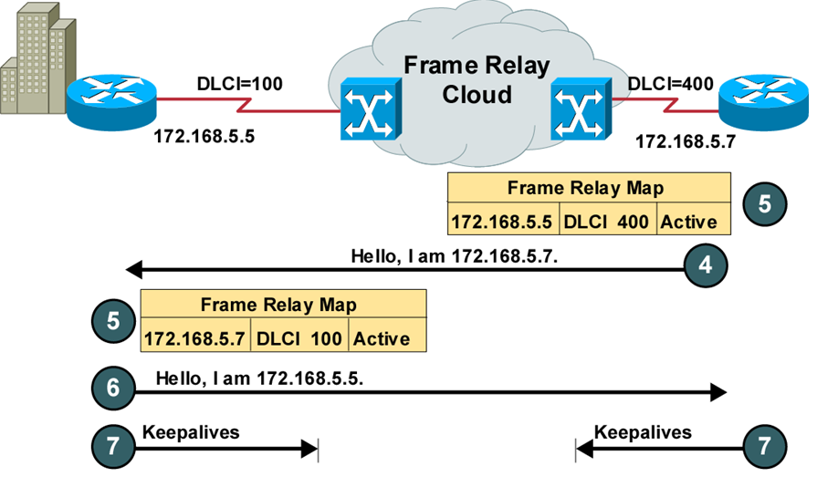
Stages of Inverse ARP and LMI Operation

Slide 16
Frame Relay Encapsulation
Specified on serial interfaces
Encapsulation types:
  Cisco (default encapsulation type)
  IETF (used between Cisco & non-Cisco devices)
    RouterA(config)#int s0
    RouterA(config-if)#encapsulation frame-relay ?
    ietf Use RFC1490 encapsulation
    <cr>

Slide 17
Data Link Connection Identifiers (DLCIs)
Frame Relay PVCs are identified by DLCIs
IP end devices are mapped to DLCIs
  Mapped dynamically or mapped by IARP
Global Significance:
  Advertised to all remote sites as the same PVC
Local Significance:
  DLCIs do not need to be unique
Configuration
    RouterA(config-if)#frame-relay interface-dlci ?
      <16-1007> Define a DLCI as part of the current subinterface
    RouterA(config-if)#frame-relay interface-dlci 16

Slide 18

DLCI’s are Locally Significant

Slide 19
LMI Types
Configuration:
    RouterA(config-if)#frame-relay lmi-type ?
    cisco
    ansi
    q933a
  Default type: cisco
Virtual circuit status:
  Active
  Inactive
  Deleted

Slide 20
Sub-interfaces
Definition
  Multiple virtual circuits on a single serial interface
  Enables the assignment of different network-layer characteristics to each sub-interface
    IP routing on one sub-interface
    IPX routing on another
  Mitigates difficulties associated with:
    Partial meshed Frame Relay networks
    Split Horizon protocols

Slide 21
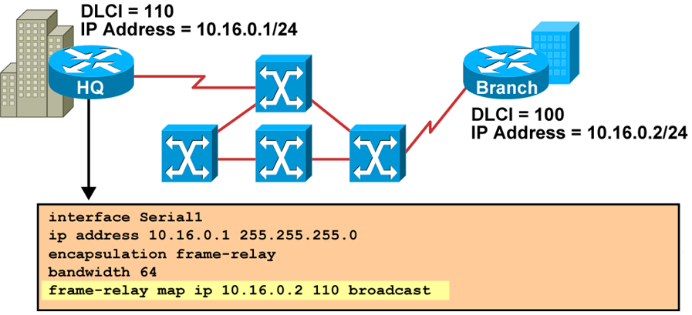
Configuring a Static Frame Relay Map

Slide 22
Configuring Sub-interfaces
  Point-to-point
    Subinterfaces act like leased lines.
    Each point-to-point subinterface requires its own subnet.
    Point-to-point is applicable to hub and spoke topologies.
  Multipoint
    Subinterfaces act like NBMA networks, so they do not resolve the split-horizon issues.
    Multipoint can save address space because it uses a single subnet.
    Multipoint is applicable to partial mesh and full mesh topologies.

Slide 23
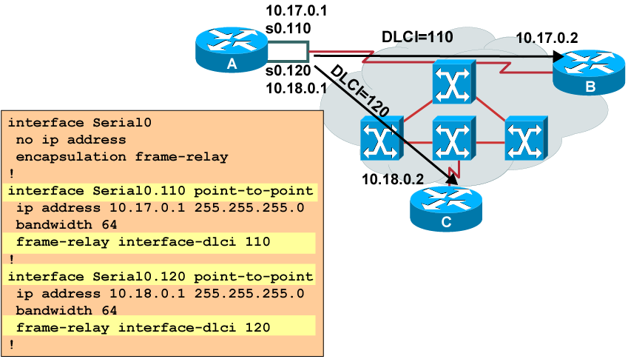
Configuring Point-to-Point Sub-interfaces

Slide 24
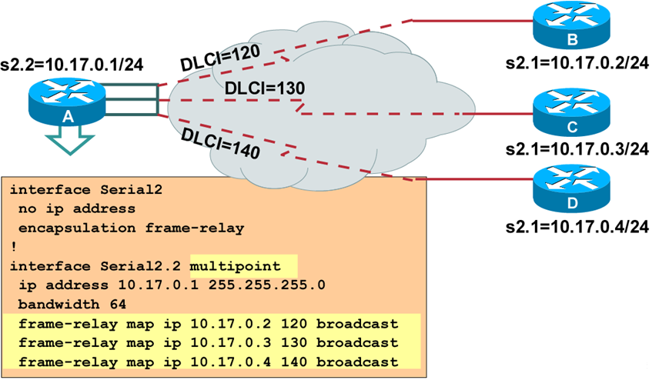
Multipoint Sub-interfaces Configuration Example

Slide 25
Verifying Frame Relay Operation
Router#show frame-relay traffic
Displays Frame Relay traffic statistics
Router#clear frame-relay-inarp
Clears dynamically created Frame Relay maps, created by using Inverse ARP
Router#show interfaces type number
Displays information about Frame Relay DLCIs and the LMI
Router#show frame-relay lmi [type number]
Displays LMI statistics
Router#show frame-relay map
Displays the current Frame Relay map entries
Router#show frame-relay pvc [type number [dlci]]
Displays PVC statistics

Slide 26
show interfaces Example
Router#show interfaces s0
Serial0 is up, line protocol is up
Hardware is HD64570
Internet address is 10.140.1.2/24
MTU 1500 bytes, BW 1544 Kbit, DLY 20000 usec, rely 255/255, load 1/255
Encapsulation FRAME-RELAY, loopback not set, keepalive set (10 sec)
LMI enq sent 19, LMI stat recvd 20, LMI upd recvd 0, DTE LMI up
LMI enq recvd 0, LMI stat sent 0, LMI upd sent 0
LMI DLCI 1023 LMI type is CISCO frame relay DTE
FR SVC disabled, LAPF state down
Broadcast queue 0/64, broadcasts sent/dropped 8/0, interface broadcasts 5
Last input 00:00:02, output 00:00:02, output hang never
Last clearing of "show interface" counters never
Queueing strategy: fifo
Output queue 0/40, 0 drops; input queue 0/75, 0 drops
<Output omitted>
  Displays line, protocol, DLCI, and LMI information

Slide 27
show frame-relay pvc Example
Router#show frame-relay pvc 100
PVC Statistics for interface Serial0 (Frame Relay DTE)
DLCI = 100, DLCI USAGE = LOCAL, PVC STATUS = ACTIVE, INTERFACE = Serial0
input pkts 28 output pkts 10 in bytes 8398
out bytes 1198 dropped pkts 0 in FECN pkts 0
in BECN pkts 0 out FECN pkts 0 out BECN pkts 0
in DE pkts 0 out DE pkts 0
out bcast pkts 10 out bcast bytes 1198
pvc create time 00:03:46, last time pvc status changed 00:03:47
  Displays PVC traffic statistics

Slide 28
show frame-relay map Example
Router#show frame-relay map
Serial0 (up): ip 10.140.1.1 dlci 100(0x64,0x1840), dynamic,
broadcast,, status defined, active
  Displays the route maps, either static or dynamic

Slide 29
clear frame-relay-inarp Example
Router#show frame-relay map
Serial0 (up): ip 10.140.1.1 dlci 100(0x64,0x1840), dynamic,
broadcast,, status defined, active
Router#clear frame-relay-inarp
Router#show frame map
Router#
    Clears dynamically created Frame Relay maps

Slide 30
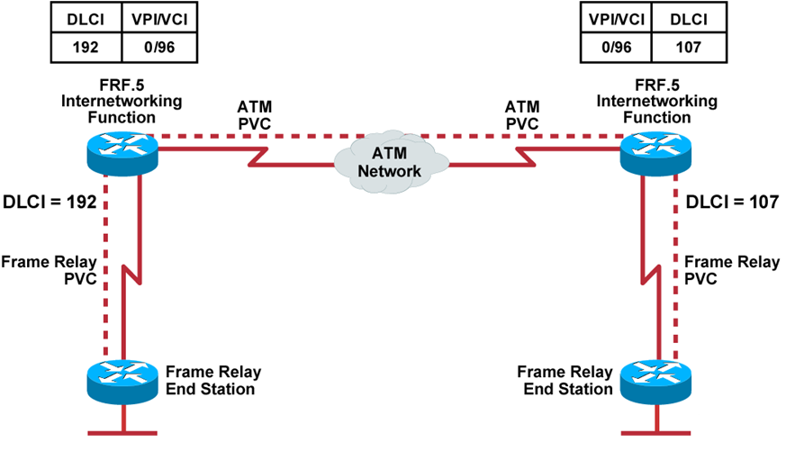
Service Provider
Frame Relay-to-ATM Interworking

Slide 31
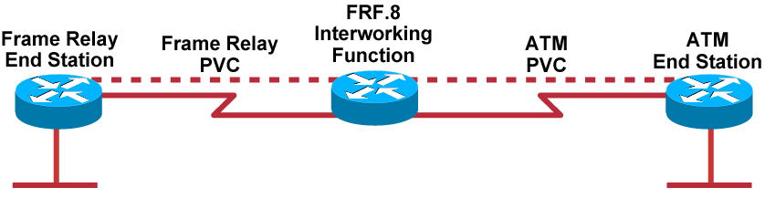
FRF.8 Service Interworking

